Slide 1
Software Testing Methodologies
Prashant Joshi

Slide 2
Module 8: Agenda
Module 8: Model Based Testing (2/2)
Topic 8.1
Model Based Testing – Systems
Topic 8.2
Model Based Testing – System of Systems
Topic 8.3
Examples

Slide 3
Topic 8.1: Model Based Testing – Systems

Slide 4
Model Based Testing
Process of creating a Model results in deeper insights and understanding of the system
Adequacy of MBT – depend on accuracy of the Model
Sequence of steps
Model the system
Identify the threads of system behavior in the model
Transform threads into test cases
Execute the test cases (on actual system) and record the results
Revise the model(s) as needed and repeat the process

Slide 5
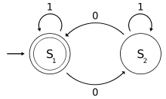
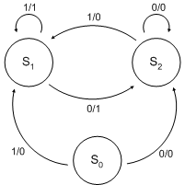
Executable Models
Finite State Machines
Petri Nets
StateCharts

Slide 6
Software Testing Methodologies
Prashant Joshi

Slide 7
Topic 8.2: Model Based Testing – System of Systems

Slide 8
System of Systems - Characteristics
A super system
A collection of cooperating systems
A collection of autonomous systems
A set of component systems

Slide 9
Specific Attributes – Maier
They are built from components that are (or can be) independent systems
They have managerial/administrative independence
They are usually developed in an evolutionary way
They exhibit emergent (as opposed to preplanned) behaviours)

Slide 10
Definitions (Maier)
A directed system of systems is designed, built, and managed for a specific purpose
A collaborative system of systems has limited centralized management and control
A virtual system of systems has no centralized management and control

Slide 11
Larger Systems
Garage Controller (Directed) – Master – Slave architecture.
Building Automation (Directed)
Air Traffic Control Systems (Collaborative)
Air Traffic Control Systems (Acknowledged) – because there is a request which needs to be acknowledged.

Slide 12
Software Testing Methodologies
Prashant Joshi

Slide 13
Topic 8.3: Examples

Slide 14
Software Testing Methodologies
Prashant Joshi

